Slide 1
Preliminary Results
US Motor Vehicle Fatalities – Vehicle Age & Model Year Impact
Comparing 2012:2015 Results to 2005:2011 Study
Sheila Pratt
March 20, 2017

Slide 2
Preliminary Results
The same general trends appear to be evident in terms of the relationship between older vehicle age and model year to the increased risk of fatal injury in a motor vehicle accident.
Restraint use continues to play a large role in the relationship between vehicle age and the percentage of drivers who were fatally injured.

Slide 3
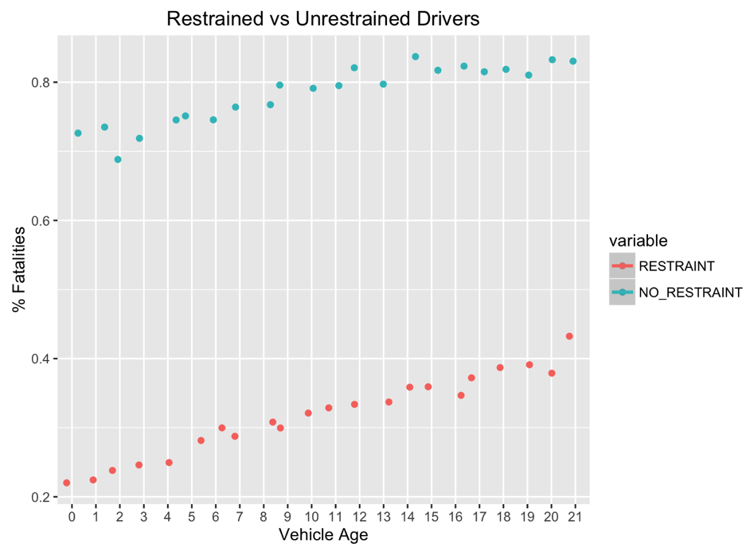
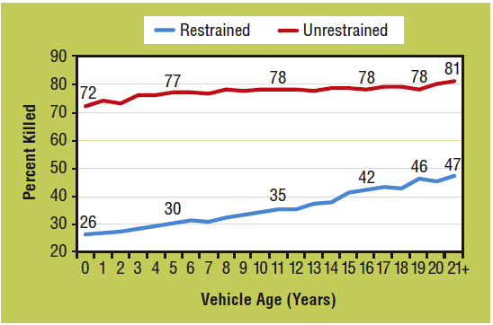
Vehicle Age & Restraint Use
2012 – 2015 Study
2005 – 2011 Study

Slide 4
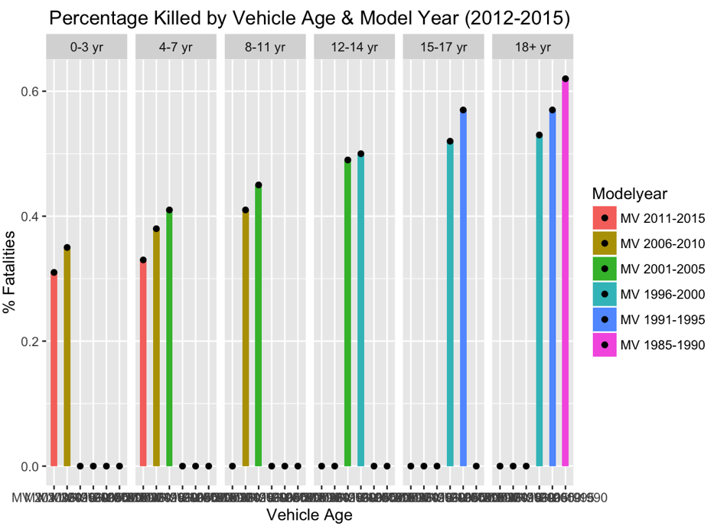
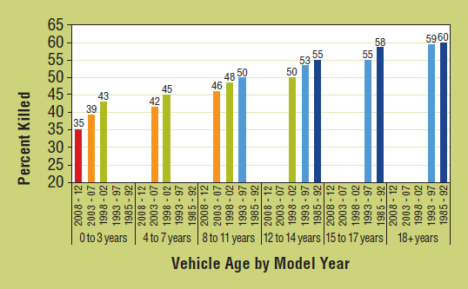
Model Year & Vehicle Age
2012 – 2015 Study
2005 – 2011 Study

Slide 5
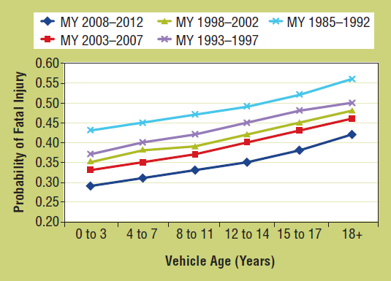
Fatality Probabilities
2012 – 2015 Study
2005 – 2011 Study

